Slide 1
Prepayment Type Electricty Meters
www.en.referanssayac.com.tr

Slide 2
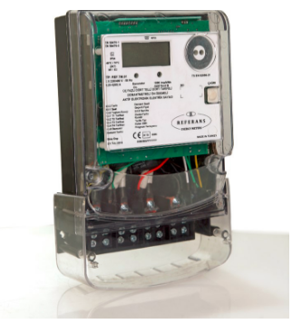
Presentation Content
Summary of the Current Situation
Intended Status
Purpose of Using Prepaid Meters
Works To Be Made
Project Technical Details

Slide 3
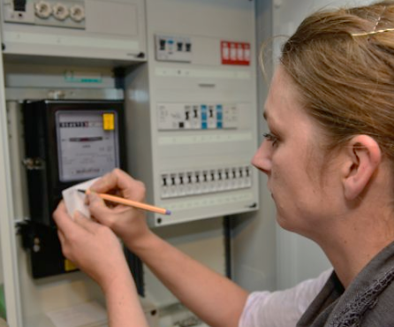
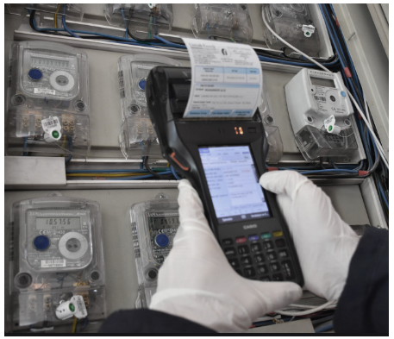
1. Summary of the Current Situation
*The customer applies to the electricity distribution company in line with his own needs and gets a subscription,
* The customer consumes energy in line with his monthly need,
* The meters are read periodically once a month,
* The monthly invoice is presented to the customer,
* If the customer does not have a problem and makes the payment, the usage continues in this way,
* If the customer has a problem in terms of payment, an interruption notice is left ,
* If the customer has not paid after a certain period of time ,the energy is cut by the teams ,
* If the customer has a problem in terms of illegal usage and the teams find this illegal usage in the routine controls, they will apply a penalty ,
* In this structure, technical and commercial loss teams must routinely control to the area.

Slide 4
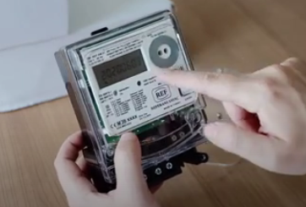
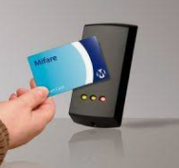
2. Intended Status
* The customer applies to the electricity distribution company in line with his own needs and
gets a subscription,
* The customer buys kwh in line with his monthly needs and loads it to his own meter,
* The meters give an alarm when the kwh is almost exhausted,if the customer makes the payment, the usage continues in this way ,
* If the customer has a problem in terms of payment, that is, he does not buy kWh, the meter cuts the energy with the internal opening-cutting relay, the customer has to buy kWh to re-energize,
* If the customer has a problem in terms of illegal useage , the meter detects it and cuts the energy with the built-in opening-breaking relay, to re-energize it must be authorized by the system administrator. Even if the customer, whose from meter is theft , purchases a contour, it cannot continue to be used ,
* In this structure, technical and commercial loss teams do not have to control the field routinely, transformer-based loss and leakage analysis is performed from the system, focusing only on the problematic area ,

Slide 5
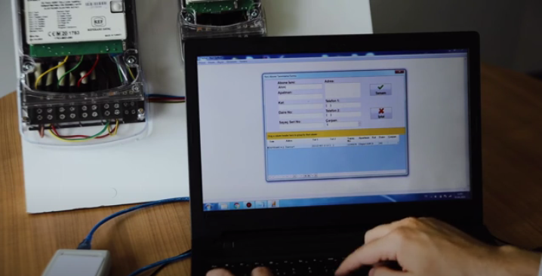
3. Purpose of Using Prepaid Meters
* To reduce monthly unnecessary operational transactions and costs,
* To make the collection before the customer uses energy,
* To provide effective Loss / Leak Control,
* To minimize subscription transactions,
* To direct the customer to savings,
* To increase customer satisfaction,
* To be able to report effectively,

Slide 6
4. Works To Be Made
* First of all, a pilot project organization of a maximum of 1000 energy meters should be made,
* During the pilot project, electrical and software training should be given to the electricity distribution company personnel,
* If the dissemination decision is taken after the pilot project, the new costs and production infrastructure should be revised in accordance with the need and agreements should be made,
* In parallel with this process, a Meter Adjustment Laboratory should be established in order to test the meter and to perform service operations ,
* Collected data should be collected at a single point with the help of web services, a team should be set up for big data analysis,
* Similarly, it should be aimed to reduce technical and commercial loss to minimum levels by analyzing transformer-based technical and commercial loss for each transformer zone .

Slide 7
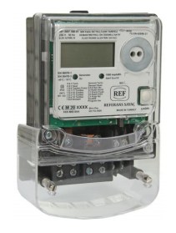
5. Project Technical Details ( Single Phase )
*Model Name : REF.SM.01(Single Phase )
*Meter Definition : 1 Phase , 2 Wires , 4 Tariffs , Demantmetered , Outdoor , Prepayment Meter
*Accuracy Class : Mode B ( Class 1 )
*Referance Voltage : 230/400V ( Compitable 240 / 400V )
*Wide InputVoltage : 120V(Minimum) – 300V(Maksimum) ( Phase To Notr )
*Frequency : 50Hz
*Take Off Current : 20mA ( 5A / 200 in standart )
*Minimum Current : 250mA
*Referance Current : 5A
*Maksimum Current : 100A

Slide 8
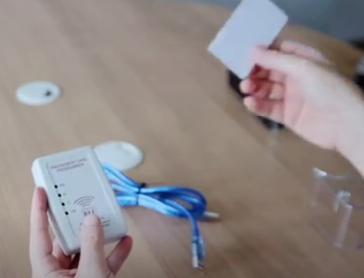
5. Project Technical Details ( Single Phase )
*IP Class : IP54
*Protection Class : 2
*Humidity Rate : %95
*Operating Temp. : -40 , +80 °C
*Mechanical Env. : M1 ( According to 2004 / 22 / EC directive )
*Elektromagnetic : E2 (According to 2004 / 22 / EC directive )
*Voltage Circuit : <1W ( Should be <2W in standart )
*Current Circuit : <0.2W ( Should be <1W in standart )
*Total Power : <1.2W ( Total power consumption per phase )
* ESD : 8KV with contacts , 15KV by air
*Impulse Voltage : 12kV
*Meter Constant : 1000imp/kWh

Slide 9
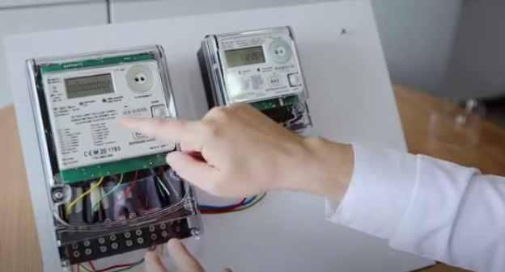
5. Project Technical Details ( Single Phase )
*LCD : 6 + 3
*Comm. Rate : 300 – 9600 ( IEC 62056-21 Mode C )
*Interface1 : Optical Port ( 300 – 9600 ) ( IEC 62056-21 Mode C )(Indepandent)
*Interface2 : Rs485 Port ( 300 – 9600 ) ( IEC 62056-21 Mode C )( Indepandent)
*Generator Tariffi : Generator tariff detection with generator auxiliary contact input
*Sys. Battary Life : 10Year
*Shutoff Structure : Internal Latch Relay
*Security Logs : Up Cover , Terminal Cover ext.
*Data Logs : 1 Year
*Related Standarts : EN 62056-11 , EN 62053-21
*Related Docs : MID compatibility

Slide 10
5. Project Technical Details ( Three Phase )
*Regulations : Compatible with international requirement (To be mutually agreed )
*Technology : Contactless communication is provided through the Mifare / RFID technology
*RFField Detection : Automatic or push button activation ( Optional )
*Alarm Circuit : Cancelable acoustic alarm circuit
*Contour back-up : Available (Optional)
*Compatibility : Since it is possible to write to the desired sectors, more than one application
can be run at the same time with the same card.
*Credit : Cutting the counter at the desired time periods with the possibility of credit is
provided.
*Easy to use : Easy installation and easy to use feature by means of an Accounting
Program (Optional)

Slide 11
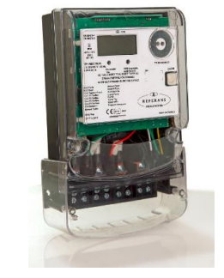
5. Project Technical Details ( Three Phase )
*Model Name : REF.TM.01(Three Phase )
*Meter Defination : 3 Phase , 4 Wires , 4 Tariffs , Demantmetered , Outdoor , Prepayment Meter
*Accuracy Class : Mode B ( Class 1 )
*Referance Voltage : 3x230/400V ( Compitable 3x240 / 400V )
*Wide InputVoltage : 120V(Minimum) – 300V(Maksimum) ( Phase To Notr )
*Frequency : 50Hz
*Take Off Current : 20mA ( 5A / 200 in standart )
*Minimum Current : 250mA
*Referance Current : 5A
*Maksimum Current : 80A

Slide 12
5. Project Technical Details ( Three Phase )
*IP Class : IP54
*Protection Class : 2
*Humidity Rate : %95
*Operating Temp. : -40 , +80 °C
*Mechanical Env. : M1 ( According to 2004 / 22 / EC directive )
*Electromagnetic : E2 (According to 2004 / 22 / EC directive )
*Voltage Circuit : <1W ( Should be <2W in standard )
*Current Circuit : <0.2W ( Should be <1W in standard )
*Total Power : <1.2W ( Total power consumption per phase )
* ESD : 8KV with contacts , 15KV by air
*Impulse Voltage : 12kV
*Meter Constant : 1000imp/kWh

Slide 13
5. Project Technical Details ( Three Phase )
*LCD : 6 + 3
*Comm. Rate : 300 – 9600 ( IEC 62056-21 Mode C )
*Interface1 : Optical Port ( 300 – 9600 ) ( IEC 62056-21 Mode C )(Independent)
*Interface2 : Rs485 Port ( 300 – 9600 ) ( IEC 62056-21 Mode C )( Independent)
*Generator Tariff : Generator tariff detection with generator auxiliary contact input
*Sys. Battery Life : 10Year
*Shutoff Structure : Internal Latch Relay
*Security Logs : Up Cover , Terminal Cover ext.
*Data Logs : 1 Year
*Related Standards : EN 62056-11 , EN 62053-21
*Related Docs : MID compatibility

Slide 14
5. Project Technical Details ( Three Phase )
*Regulations : Compatible with international requirement (To be mutually agreed )
*Technology : Contactless communication is provided through the Mifare / RFID technology
*RFField Detection : Automatic or push button activation ( Optional )
*Alarm Circuit : Cancelable acoustic alarm circuit
*Contour back-up : Available (Optional)
*Compatibility : Since it is possible to write to the desired sectors, more than one application
can be run at the same time with the same card.
*Credit : Cutting the counter at the desired time periods with the possibility of credit is
provided.
*Easy to use : Easy installation and easy to use feature by means of an Accounting
Program (Optional)

Slide 15
Thank You !
Danke!
شكرا لك !
Teşekkürler!
TEŞEKKÜRLER

